Slide 1

Automated Generation of Modular and Dynamic Industrial Process Plant Visualizations
Bachelor Thesis
Miguel Romero Karam

Slide 2
ProcAppCom Project Overview
[Insert puzzle pieces picture here]

Slide 3
Bachelor Thesis Introduction
Motivation:
Development and modification of Plant Visualizations is cost and time intensive.
Problem Definition:
Automated generation of modular and dynamic plant P&ID visualizations necesarry
with minimal user configuration and
integration to the MES software at hand.
Goals
Reduce technical effort and accelerate P&ID creation
Standarization of P&ID symbols
Prototypal Implementation in a MES

Slide 4
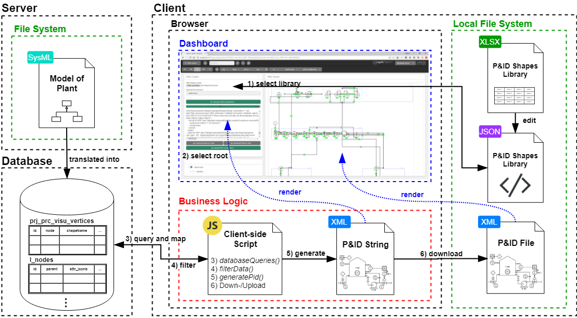
Software Architechture Aligning to Legato

Slide 5
Software Architechture Scope of this Project
Notes:
-Development entirely on the client-side
-3 Major parts to the developed solution…

Slide 6
Software Architechture 1. P&ID Shapes Library

Slide 7
Software Architechture 2. GUI (Dashboard)

Slide 8
Software Architechture 3. Client-side Script

Slide 9
Software Architechture 1. P&ID Shapes Library
Notes:
-To be saved in the local file system

Slide 10
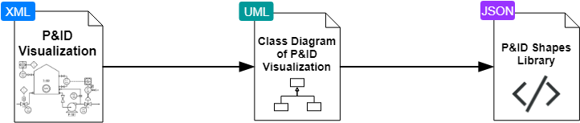
P&ID Shapes Library Objected Oriented Abstraction of Shapes
Notes:
Likewise, the process for the conception of the shapes library happened in 3 main parts…

Slide 11
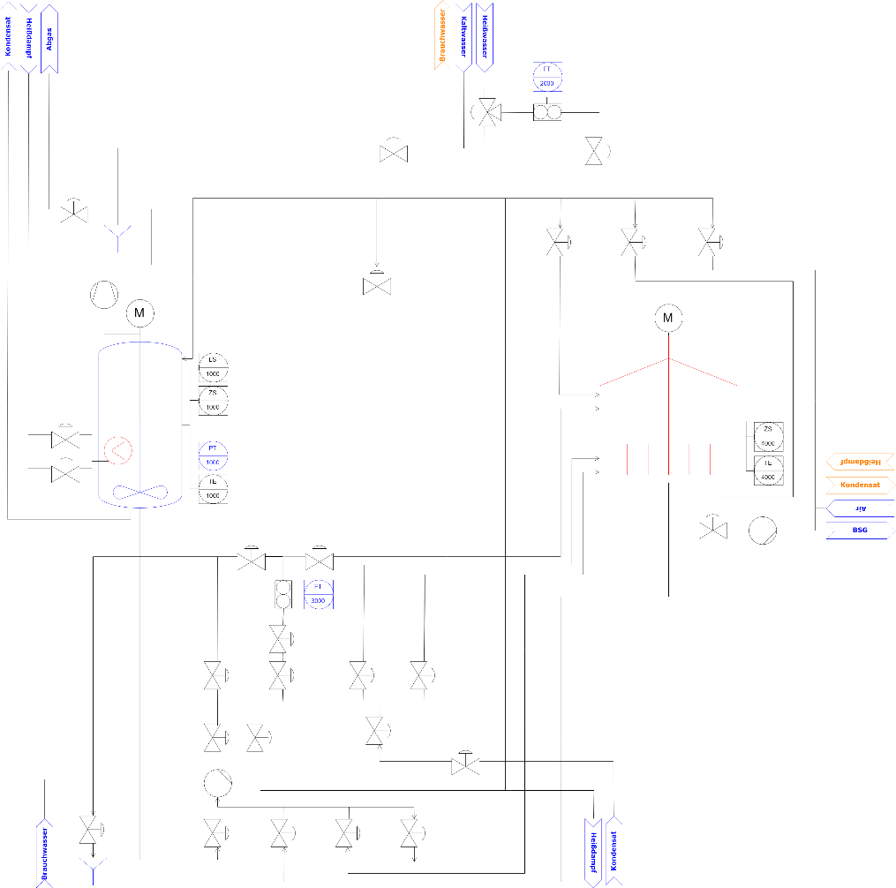
P&ID Shapes Library Objected Oriented Abstraction of Shapes
P&ID of Aida Brewery
Notes:
First, the ideal P&ID of the Aida Brewery was
-manually drawn with the tools to be used
-aligning to the requirements set at the start of the project for the final P&ID (for example, it was decided what contents the P&ID should at least include)

Slide 12
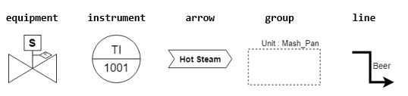
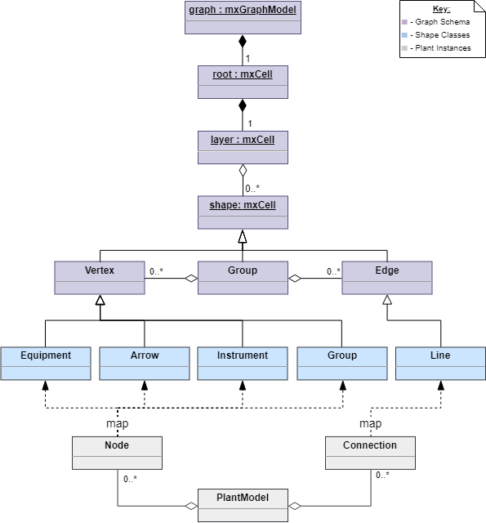
P&ID Shapes Library Objected Oriented Abstraction of Shapes
Class Diagram of P&ID
Notes:
Second was the object-oriented abstraction of the shapes into 5 elementary Classes. For this, the P&ID was
-exported in XML format
-analysed and compared to the mxGraph API documentation
-structured into a UML class diagram of the Underlying Schema

Slide 13
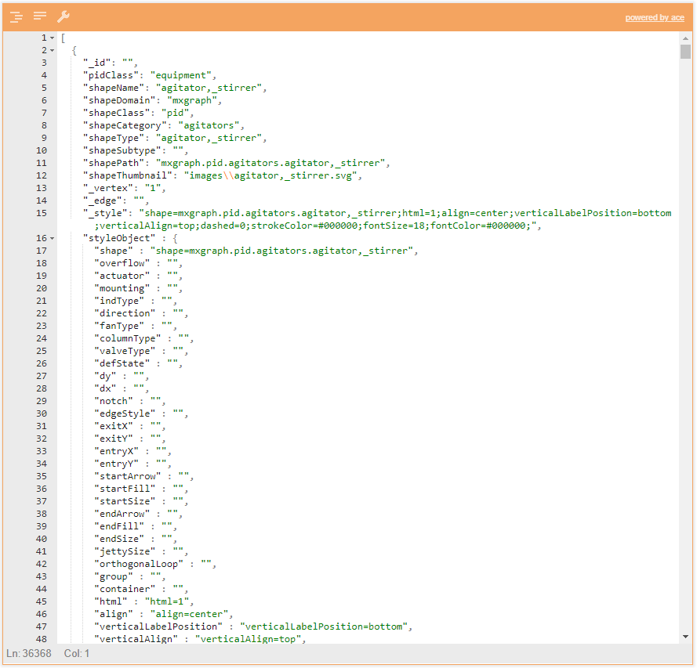
P&ID Shapes Library Objected Oriented Abstraction of Shapes
P&ID Shapes Library (474)
Notes:
Finally,
-a flat JSON file was created following this schema definition
-for all Process Engineering Symbols of the Draw.io standard library (474 shapes in total)
-JSON file contains the static definition of all shape geometries according to industry standards (no need for modification)
Additionally, Excel file created in parallel to allow for easier customizing of the shapes

Slide 14
Software Architechture 2. GUI (Dashboard)
Notes:
-User-friendly interface for rapidly creating P&ID visualizations of the user selected node hierarchy

Slide 15
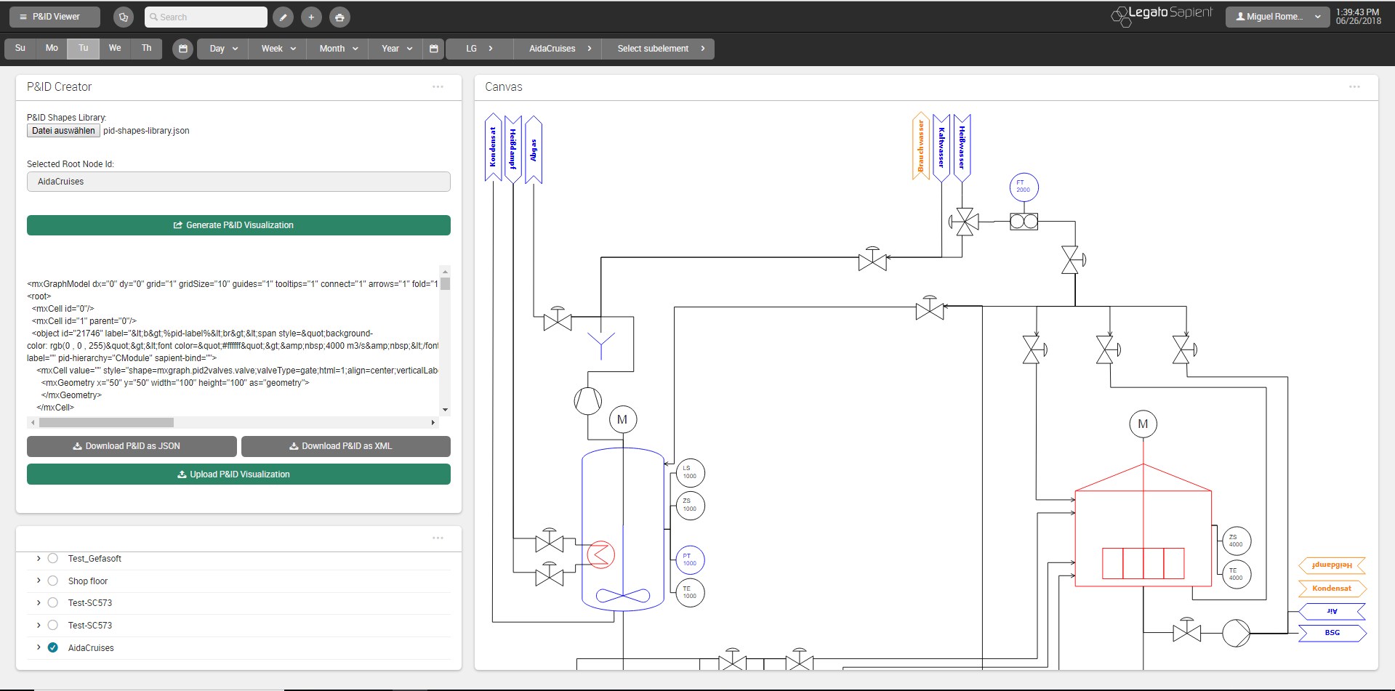
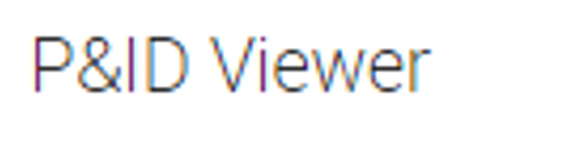
GUI P&ID Viewer Dashboard
Notes:
-Final result was to be delivered in form of a Legato Web App Dashboard
-Take advantage of already exsisting Legato Boardlets:
-Legato Graphic Designer boardlet (for the rendering of the P&ID)
-Node Tree Menu boardlet (for the selection of the desired root node for the visualization)

Slide 16
GUI P&ID Viewer Dashboard
Notes:
-So ultimately, only one boardlet was required to be developed (to encapsulate everything for the generation of P&ID visualizations)

Slide 17
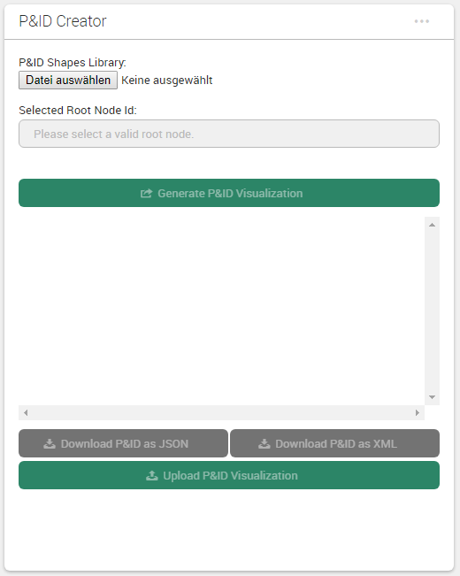
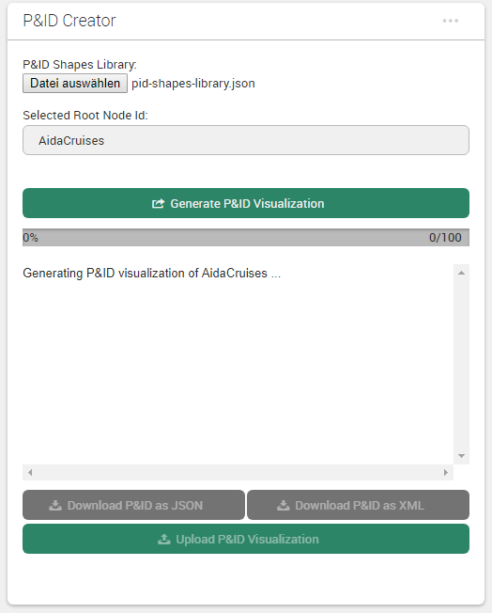
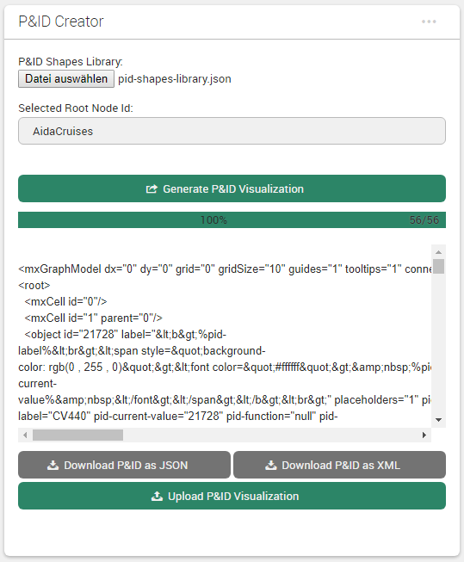
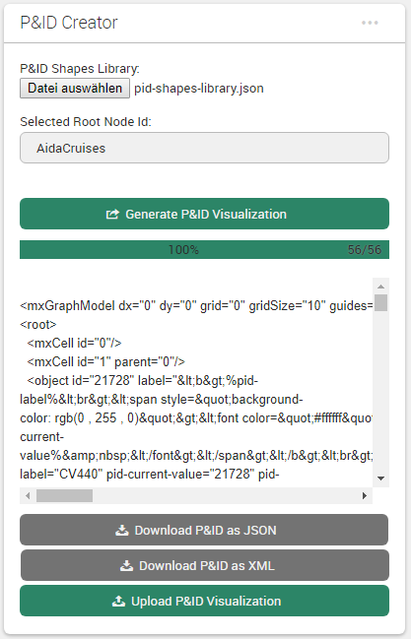
GUI P&ID Creator Boardlet
1. On start
2. In progress
3. Done
desktop
mobile
Notes:
On start, there are only 3 straight-forward steps required from the user:
Selection of the shapes library file
Selection of the root node of what is to be visualized
Clicking the “Generate P&ID Visualization” button to start the background generation of the P&ID
Afterwards, while the P&ID generation is in progress, progress bar displayed (with the total number of nodes of the selected root node hierarchy)
When done, the P&ID XML will be rendered for easy copy-pasting to draw.io for example
Note the responsive design of the boardlet

Slide 18
Software Architechture 3. Client-side Script
Notes:
-Runs entirely on the client to generate the P&ID in XML format

Slide 19
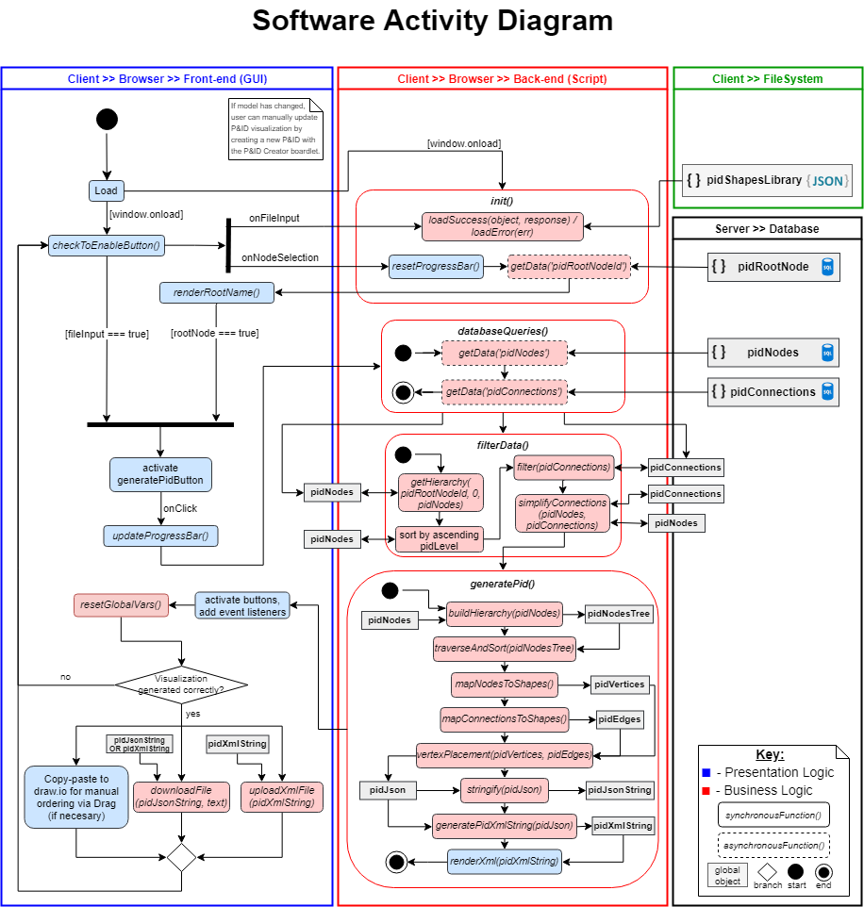
Script Activity Diagram
Notes:
This activity diagram encompasses all logic of the system, both:
-presentation logic (shown in blue) and
-business logic (shown in red and responsable for the generation of the P&ID)

Slide 20
VEREINFACHEN Activity Diagram
Notes:
This activity diagram encompasses all logic of the system, both:
-presentation logic (shown in blue) and
-business logic (shown in red and responsable for the generation of the P&ID)

Slide 21
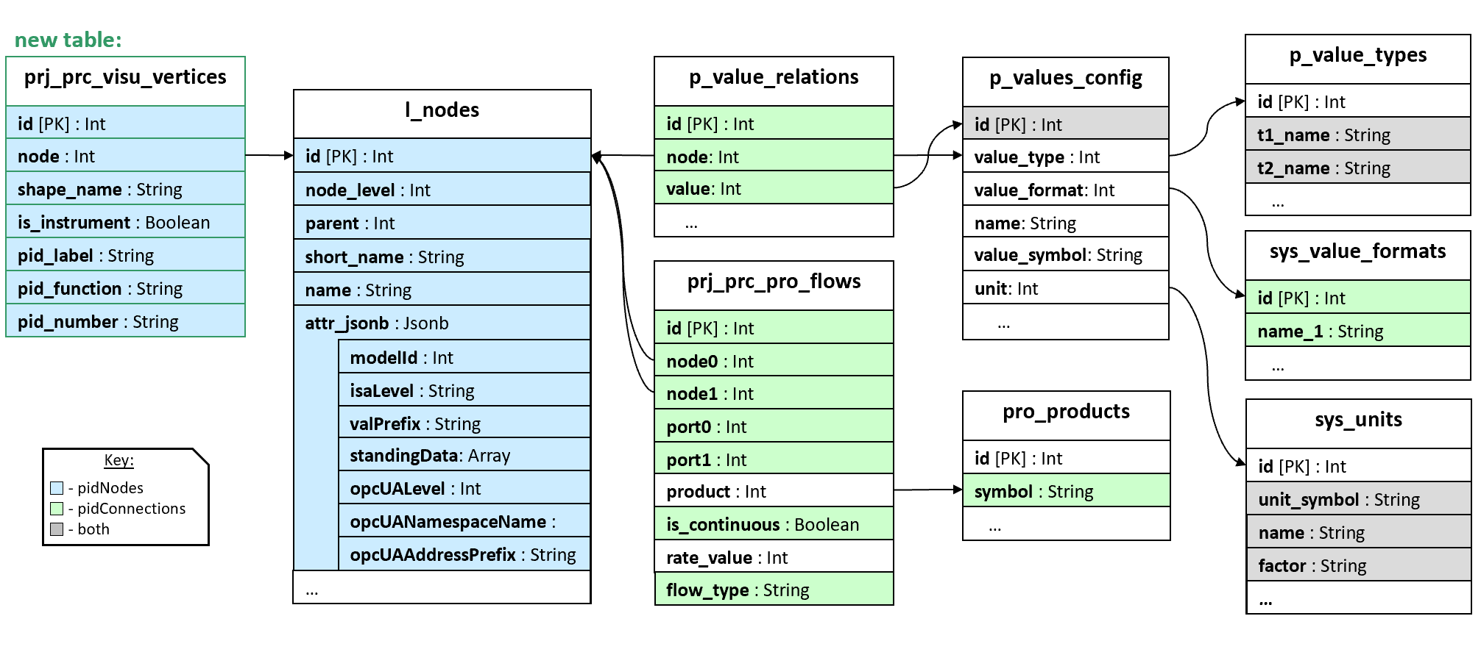
Fetching Data Global Data Map
Joins ueber mehrere Tabellen um alle daten abzuholen nach diesem Schema
Notes:
Shown is the data map of all required database atributes for the P&ID generation
-Only a single table had to be added to the database (Visu_vertices)
-All Object-relational mapping is done through a single attribute (shapeName)

Slide 22
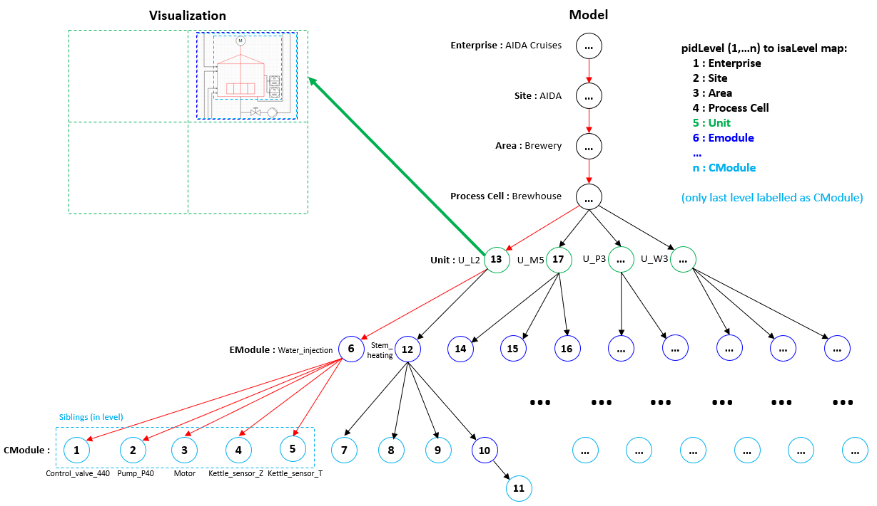
Graphing Algorithm Concept: From Node Tree to Visualization

Slide 23
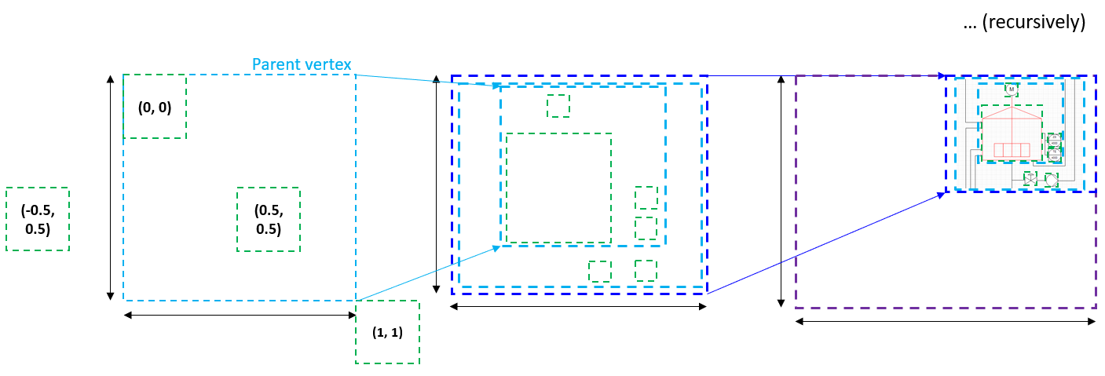
Graphing Algorithm Concept: Relative Positioning

Slide 24
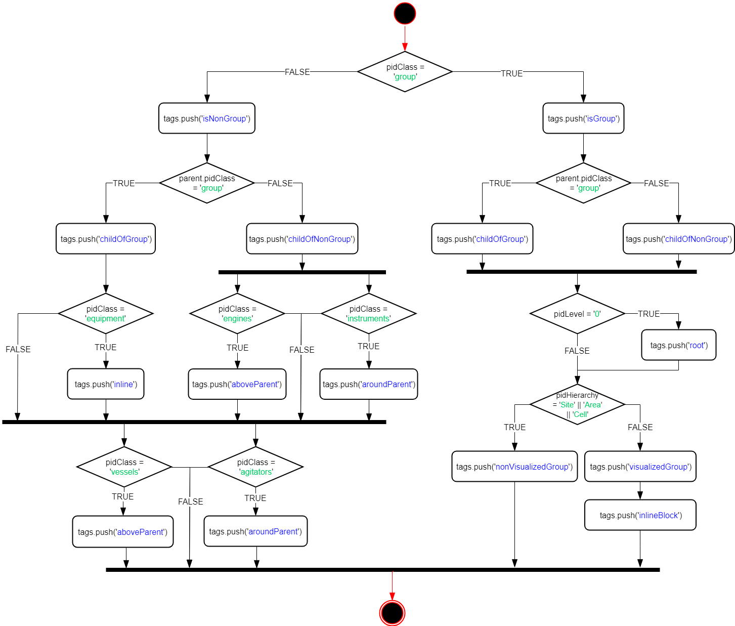
Graphing Algorithm 1. Specification of Constraints

Slide 25
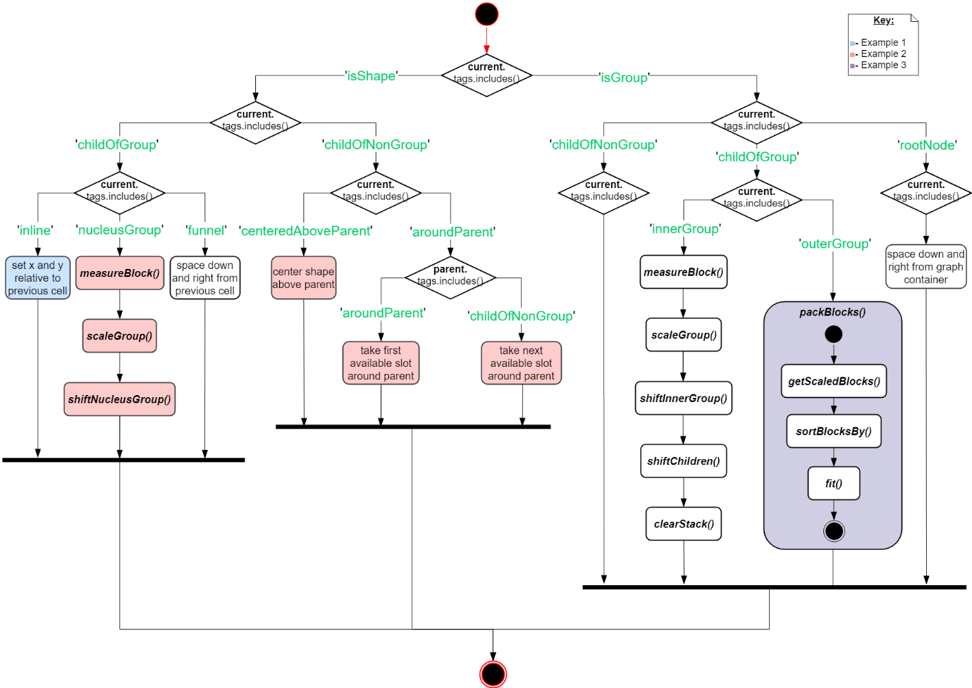
Graphing Algorithm 2. Vertex Placement
Notes:
This activity diagram covers all positioning logic for the placing of the vertices.
For the sake of brevity, 3 example positioning cases will be presented in the next slides to describe some of this positioning logic

Slide 26
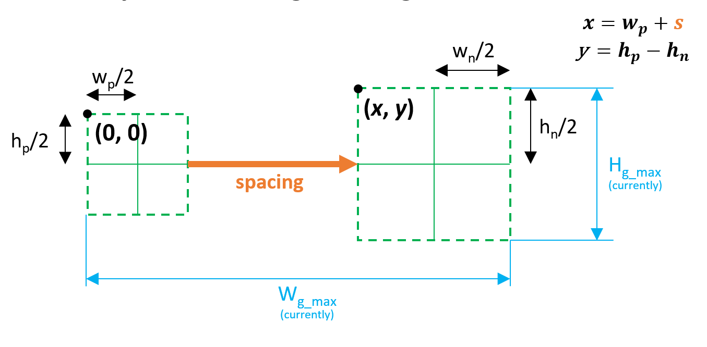
Example 1 Consecutive Inline Shapes

Slide 27
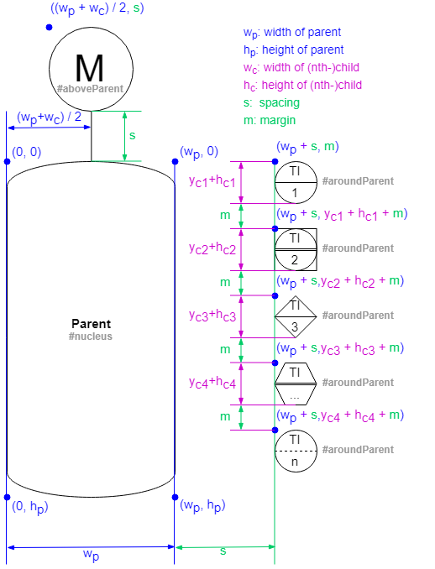
Example 2 Nucleus Shape and its Children

Slide 28
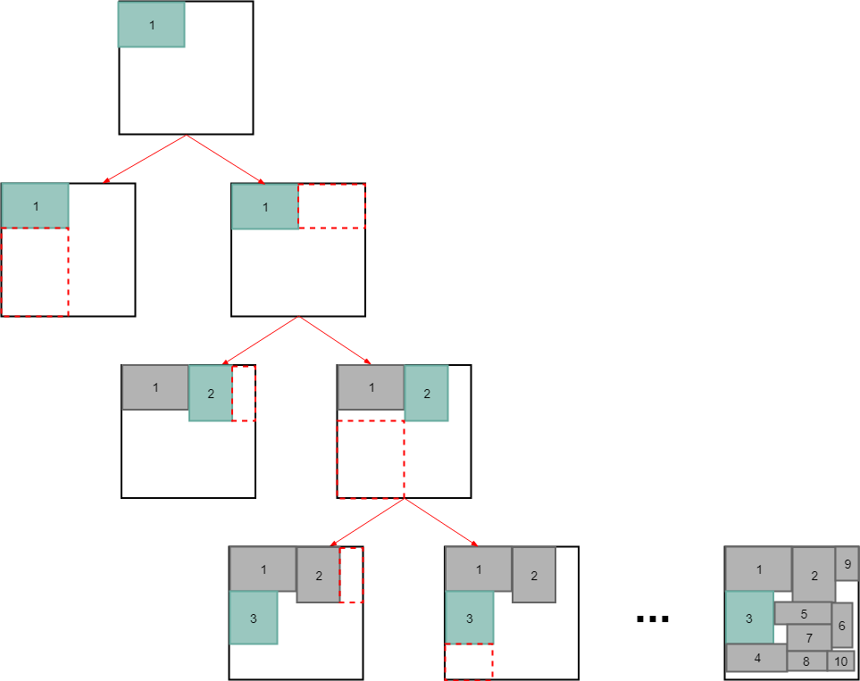
Example 3 Outer Groups with only Group Children

Slide 29
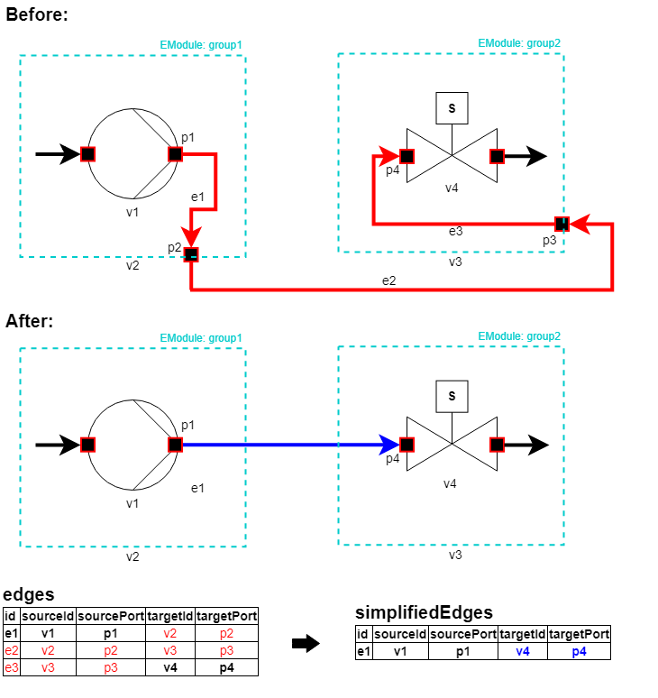
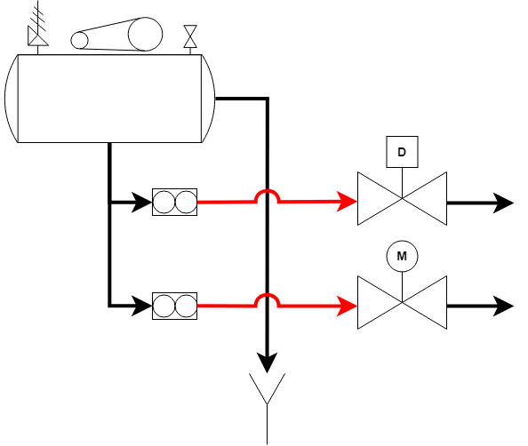
Graphing Algorithm Drawing of Connections
Simplification
Applying Line Jumps

Slide 30
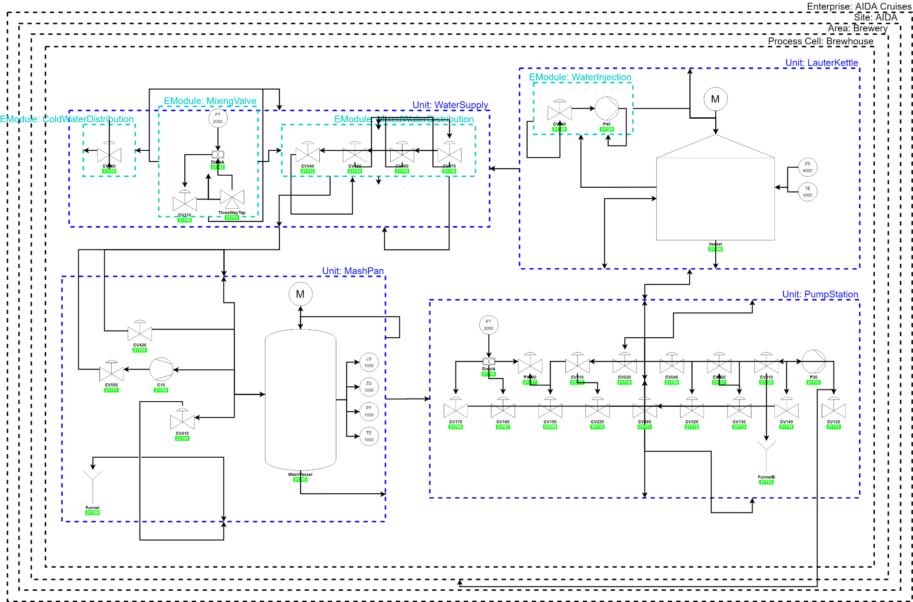
Result P&ID of Aida Brewery

Slide 31
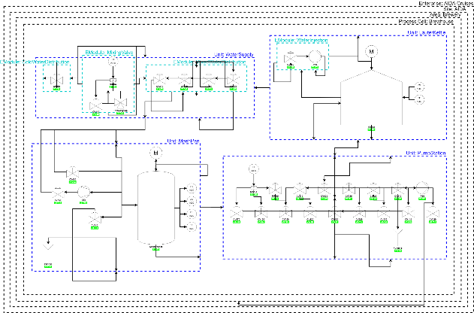
Result P&ID of Aida Brewery

Slide 32
Bachelor Thesis Evaluation and Next Steps
Stillstand reached with the Vertex Placement Alrogithm

Slide 33
Corrections
Generic Layout Boardlet (existsts already but only squres and no connections)
Detailed layout boardlet (with draw.io) XML with my boardlet generated
Architecture simplify!
Goals am ende und wie erreicht am ENDE
After that Next Steps and Last thinking sentence
Platzierung schwierig
Aber noch verbessbar (durch formulation mehrere/verfeinerug regeln)
Im rahmen eine BA nicht moglich war regeln so zu verfiner für eine perfekte P&ID in nur 6 monate zu schaffen
PID sichtbar machen! Und alles
Activity diagram von script vereinfachen um bezug zu halten
Stichtpunkte fuer 3 placing beispiele (was ich erzaehle)
Beim results noch sagen dass die noch manuel adaptierbar sind und sagen wass schon gemacht wurde

